Slide 1
Tower of Terror
Well sort of scary maybe

Slide 2
STEM
Science- Systemic study of structure and behavior of physical and natural world
Technology – Application of scientific knowledge for practical purposes
Engineering – The utilization of science and mathematics to design and create items and systems useful to people
Mathematics – The systemic abstract treatment of the relationship between values, relationships, and concepts

Slide 3
Challenge Overview
Build tower to hold a golf ball high above the ground
Transport the golf ball with minimal human intervention to new tower
New tower holds golf ball above the ground as close to original height as possible

Slide 4
Science Concepts
Static Forces
Kinetic Forces
Motion
Momentum

Slide 5
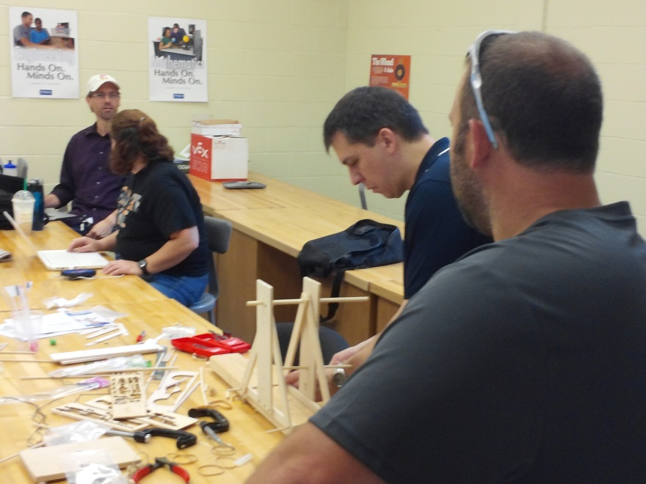
Technology
Problem Solving Method
Design
Brainstorming
Redesign

Slide 6
Engineering
Engineering Process
Technical Design
Testing
Data Analysis
Redesign
Analysis

Slide 7
Mathematics
Measurement
Geometric shapes and properties
Data Analysis
Deduction

Slide 8
Challenge Specifications - Criteria and Constraints
May only uses straws, tape, pipe cleaners, and paper provided
Structures must be free standing
During judging and transfer teams may only touch the structures to “flip a switch" or otherwise start the movement of the ball. Teams may not touch ball during movement.
Scoring:
The team will receive one point for each inch above the ground (measurements are truncated so that 1.8 inches above the ground counts as one inch) the 1st structure holds the ball.
If the ball successfully moves from one tower the other team will receive 10 points for each inch above the ground the ball is in the second tower.
The teams score will be multiplied by the “distance in inches between the two towers minus three inches”.

